Slide 1
Creating QGIS Plugin

Slide 2
QGIS Plugin Creation
Required Software :
QGIS - https://www.qgis.org/en/site/forusers/download.html
Qt Creator - https://doc.qt.io/qt-5/index.html
Optional – Qt 5 Designer
Python IDE

Slide 3

Helpful Plugins in QGIS
Step 1 : Install QGIS and open the application
Step 2 : Go to Plugins -> Manage and Install Plugins...
Step 3 : Click on "All". Search for Plugin Builder and Plugin Reloader.
Step 4 : Install the two plugins stated above.

Slide 4
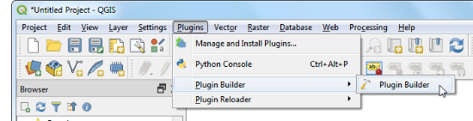
Procedure
Open QGIS. Go to Plugins -> Plugin Builder -> Plugin Builder

Slide 5
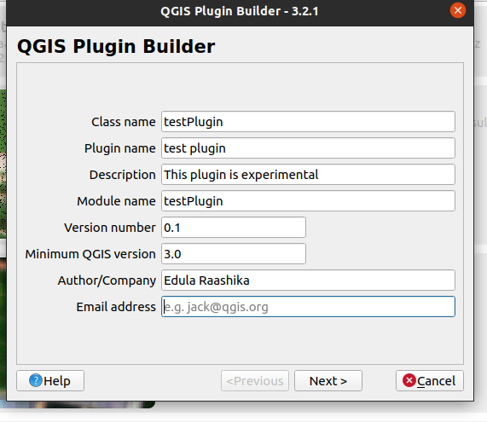
Procedure
You will see the QGIS Plugin Builder dialog with a form. You can fill the form with details relating to our plugin. The Class name will be the name of the Python Class containing the logic of the plugin. This will also be the name of the folder containing all the plugin files.

Slide 6
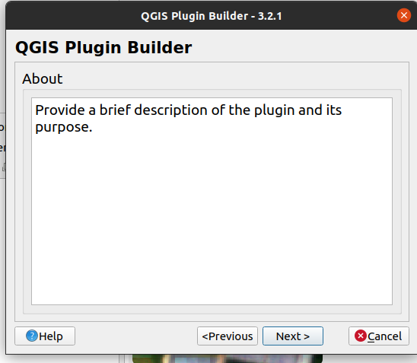
Procedure
Provide a brief description about the plugin if necessary.

Slide 7
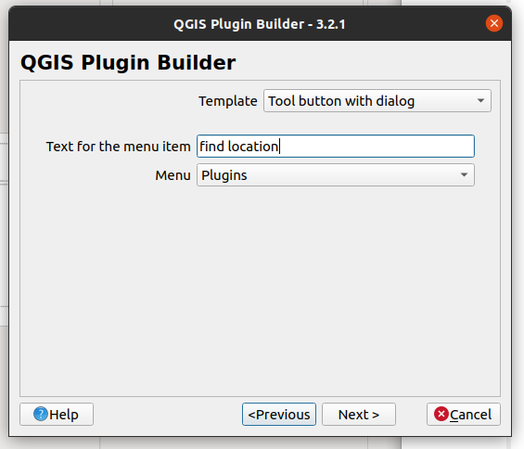
Procedure
Select the Tool button with dialog from the Template Selector. The Text for menu item value will be how the users will find your plugin in QGIS menu.

Slide 8
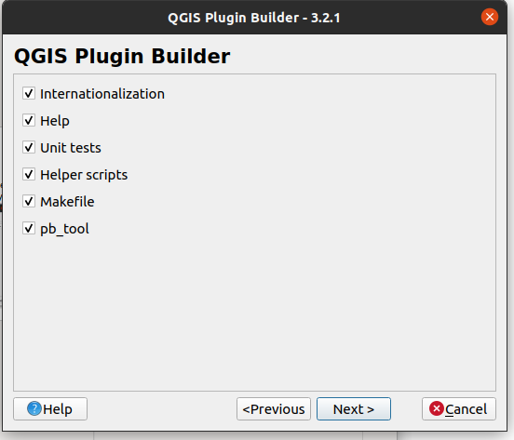
Procedure
Plugin builder will prompt you for the type of files to generate. Keep the default selection and click Next.

Slide 9
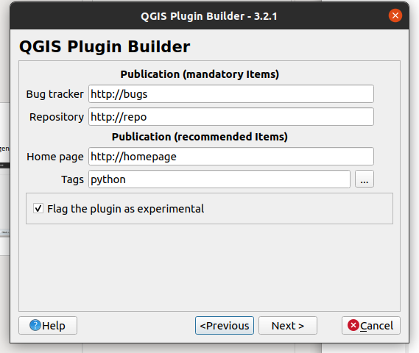
If you intend to publish the plugin, you may enter the details of repository and home page values. Check the Flag the plugin as experimental box at the bottom and click Next.

Slide 10
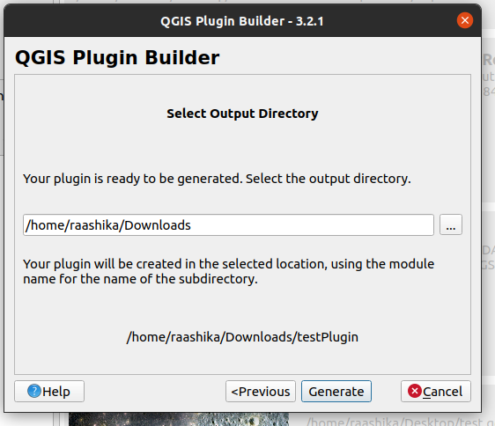
Choose a directory for downloading your plugin and click on Generate.
Click ok in the next dialog and you can find your plugin in the selected directory

Slide 11
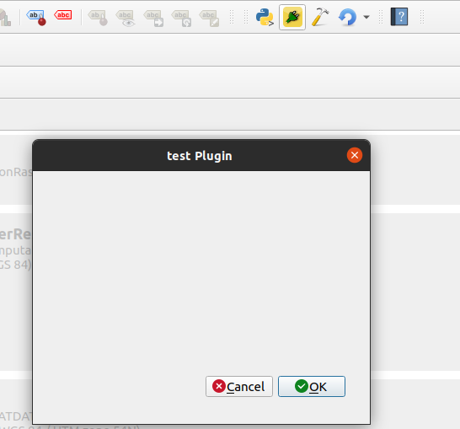
Refer "InstallationFromZipFile" manual on github to install the plugin downloaded earlier in QGIS. (github link for manual).
You can see your plugin as below.
Click here
Dialog of your plugin appears

Slide 12
Designing QGIS Plugin

Slide 13
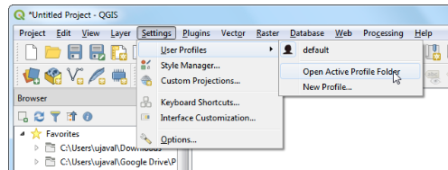
Locating Plugin Folder
Plugins in QGIS are stored in a special folder. In QGIS, locate your current profile folder by going to Settings -> User Profiles -> Open Active Profile Folder.
Go to python -> plugins. You will find folders of all installed plugins including your plugin here. Open your plugin folder.

Slide 14
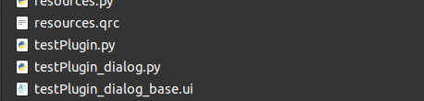
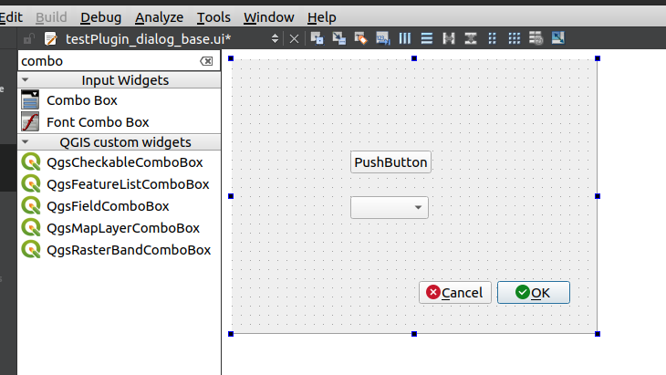
Designing and Editing Plugin dialog box
Open .ui file with Qt Creator .
Edit your dialog box with available options.
Refer Qt creator documentation and
Tutorials for more information.
Qt Creator Tutorial Link

Slide 15

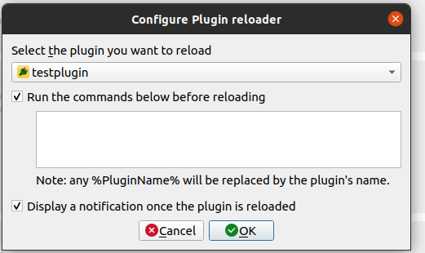
Designing QGIS Plugin
After completing design of your dialog box. Save the .ui file in Qt Creator. (Click Ctrl + S or select File -> and save the file).
To reflect the changes made in QGIS.
click on Reload Plugin – select configure – select your plugin
Select plugin
Click OK

Slide 16
QGIS Plugin Development

Slide 17

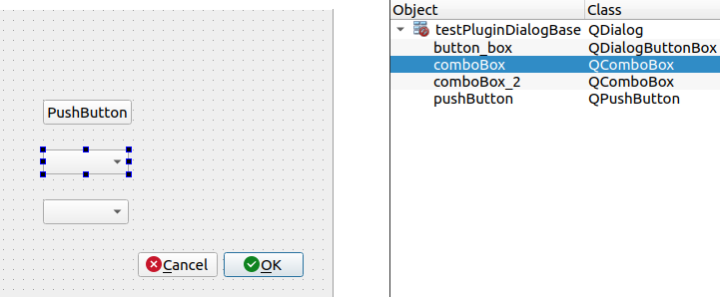
Plugin Development
Open your plugin.py file from Settings -> User Profiles -> Open Active Profile Folder -> python -> plugins -> your plugin.
Open .ui file in Qt Creator. Check the name of the label in the object window. Edit your python file to perform action when certain button is clicked or action to do.

Slide 18
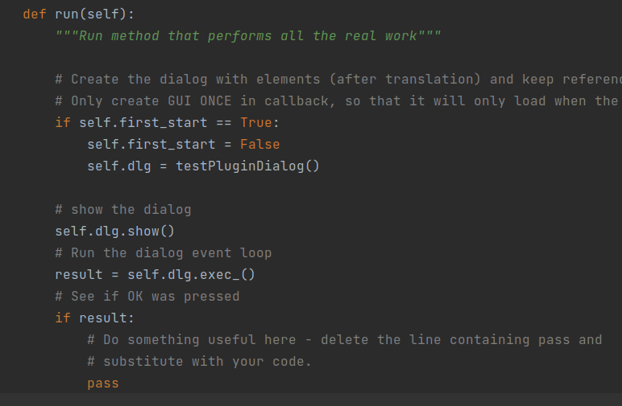
Add your python code to perform actions in run function.
Save the python file after editing and reload plugin using "Plugin Reloader" to reflect the changes in QGIS.
Refer available Plugins for help.

